Slide 1


SQL PROJECT
By: Janvi Dhonde

Slide 2



The primary objective of the music store is to achieve sustainable
business growth while addressing existing challenges.
We need to examine the dataset with SQL and help the music store
understand its business growth by answering simple questions.

Slide 3






Queries Include:
SELECT, GROUP BY, ORDER
BY , LIMIT, DESC
Queries Include:
JOINS, GROUP BY, ORDER BY , LIMIT, DESC
Queries Include:
CTE (COMMON TABLE EXPRESSIONS), WINDOWS FUCTIONS

Slide 4


Question-1
Who is the senior most employee based on job title?

Slide 5

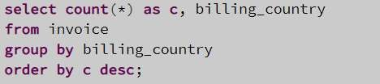
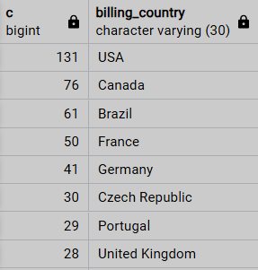
Question-2
Which countries have the most Invoices?

Slide 6

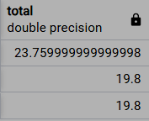
Question-3
What are top 3 values of total invoice?

Slide 7
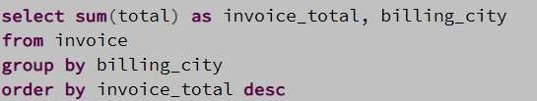

Question-4
Which city has the best customers? We would like to throw a promotional Music Festival in the city we made the most money. Write a query that returns one city that has the highest sum of invoice totals. Return both the city name & sum of all invoice totals

Slide 8
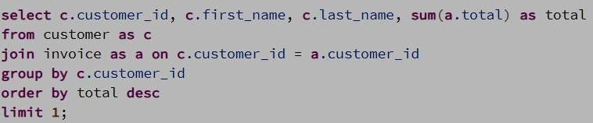

EASY QUESTIONS
Question-5
Who is the best customer? The customer who has spent the most money will be declared the best customer. Write a query that returns the person who has spent the most money.

Slide 9

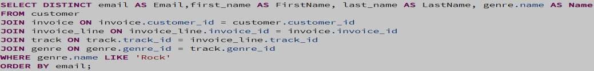
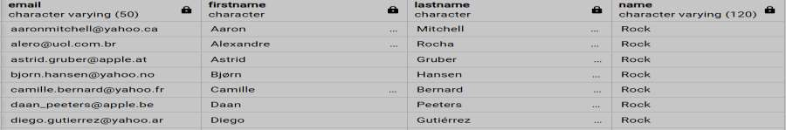
MODERATE QUESTIONS
Question-1
Write query to return the email, first name, last name, & Genre of all Rock Music listeners.
Return your list ordered alphabetically by email starting with A.

Slide 10

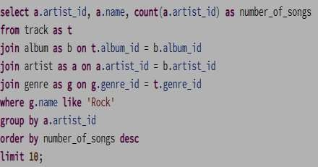
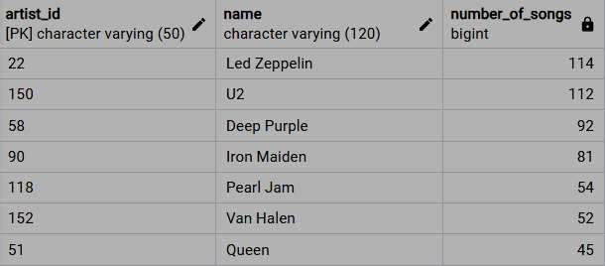
MODERATE QUESTIONS
Question-2
Let's invite the artists who have written the most rock music in our dataset.
Write a query that returns the Artist name and total track count of the top 10 rock bands.

Slide 11
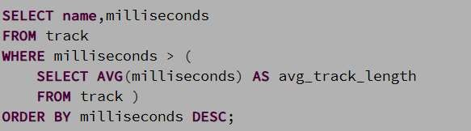
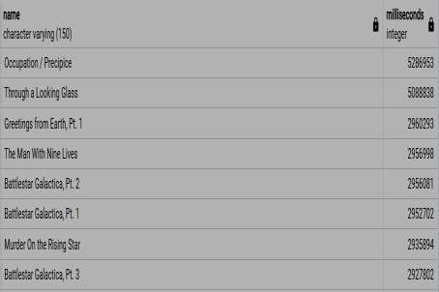
MODERATE QUESTIONS
Question-3
Return all the track names that have a song length longer than the average song length. Return the Name and Milliseconds for each track. Order by the song length with the longest songs listed first.

Slide 12

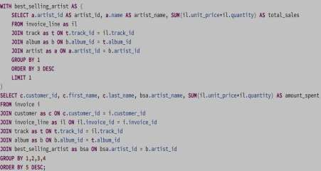
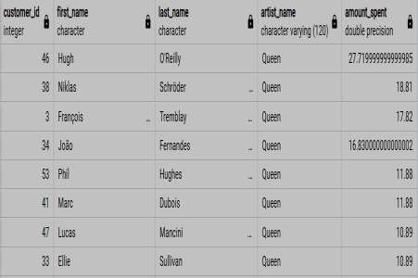
ADVANCE QUESTIONS
Question-1
Find how much amount spent by each customer on artists? Write a query to return customer name, artist name and total spent.

Slide 13

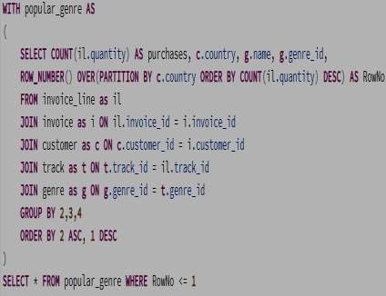
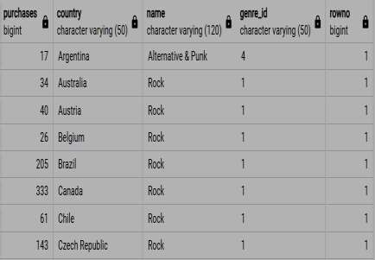
Question-2
We want to find out the most popular music Genre for each country. We determine the most popular genre as the genre
with the highest amounts of purchases. Write a query that returns each country along with the top Genre. For countries
where the maximum number of purchases is shared return all Genres.

Slide 14
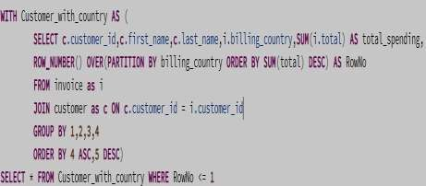
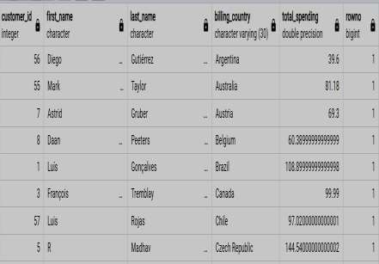
Question-3
Write a query that determines the customer that has spent the most on music for each country. Write a query that returns the country along with the top customer and how much they spent. For countries where the top amount spent is shared, provide all customers who spent this amount.

Slide 15


THANK YOU

